Slide 1

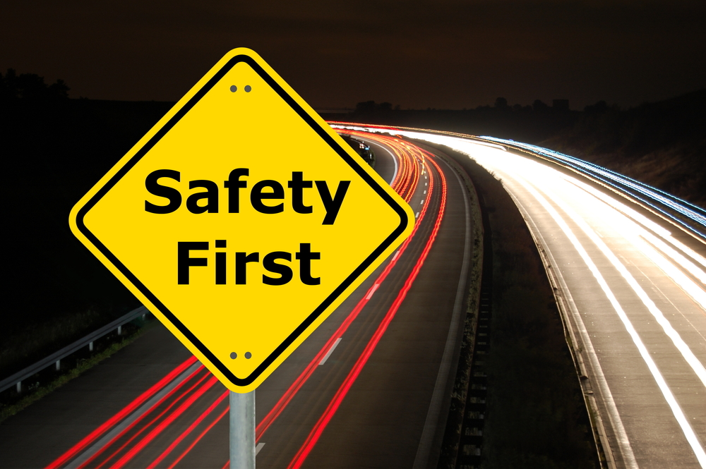
SAFE DRIVING
WHY
and
HOW

Slide 2
WHY?
Avoid the accidents
Avoid lost Liability Costs

Slide 3
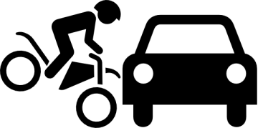


WHY: avoid the accidents
20,280
8.279
The Global Status Report released by WHO this year confirms that road traffic injuries are still a big global health and development problem.
17.040
Notes:
- injured

Slide 4
WHY: avoid lost Liability Costs
If you don't drive safely, you may infringe the traffic rules.
Then you have to:
Pay infringement fee.
Your licence may be kept by the police temporarily.

Slide 5
HOW: Factors that help driving safely
Traffic vehicles preparing.
Deal with weather & road conditions.
Drivers.

Slide 6

HOW: Vehicles preparing: vehicle inspection and maintenance
Regular tune-ups and check: daily, weekly and periodically
Walk around inspection
check inside: engine, brake, ...
Windows clean, wipers, nothing blocking vision
Lights, signals working properly
rearview, mirrors properly adjusted
Oil changes
Tires

Slide 7
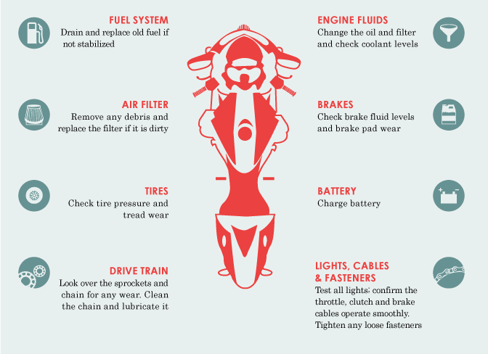
HOW: Vehicles preparing: vehicle inspection and maintenance

Slide 8
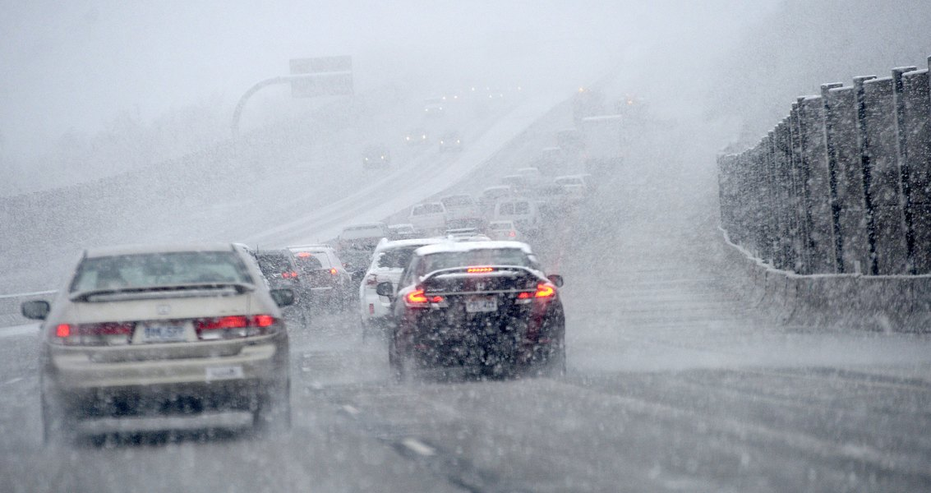
HOW: Deal with weather and road conditions

Slide 9
HOW: Deal with weather and road conditions
Read weather news before drive.
Prepare Your vehicle for Bad Weather
If You’re Driving on Snowy or Icy Roads:
Slow down
Keep a safe following distance
If You’re Driving in Foggy Conditions:
Turn on the fog lights
Slow down

Slide 10
HOW: Deal with weather and road conditions
If You’re Driving in Rainy Weather:
Slow down by at least 5 or 10 kilomets an hour
Avoid driving through flooded areas
Keep clean vision.
If You’re Having Car Trouble:
Make sure your car is out of the way of traffic: Pull off the road and put on your hazard lights
Don’t wander off: It’s easy to lose direction in a storm. Stay with your car until help arrives.

Slide 11
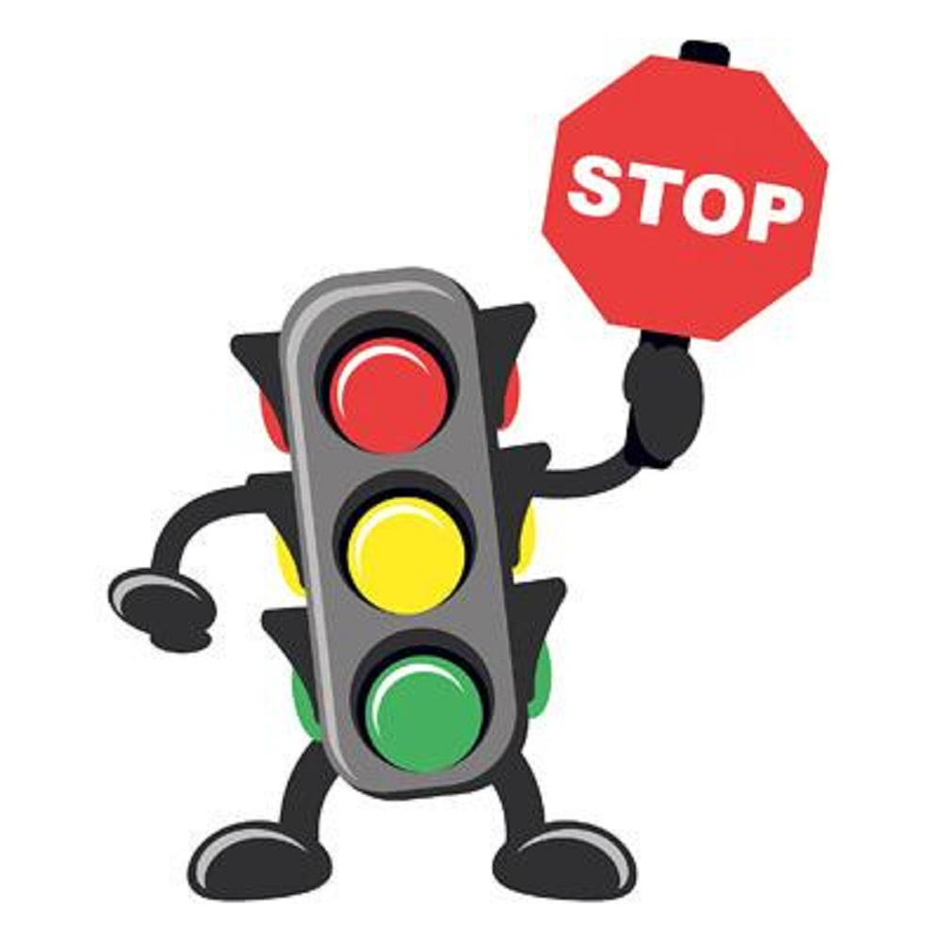
HOW: Driver factor
Driving licence: it identifies that you as a licensed driver, first condition to drive. earned by pass an examination
Obey traffic rules:
obey light signals,
traffic controller

Slide 12
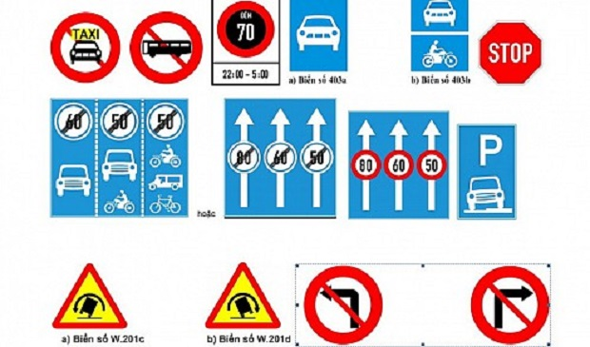
HOW: Driver factor - Obey traffic rules
Obey traffic signs and signals:
Prohibitive signs
Danger warning signs
Direction signs
Mandatory signs

Slide 13


HOW: Obey traffic signs and signals
Prohibitive signs:
Notes:
Yield to oncoming traffic
are usually red bordered white circles. They sometimes have a red slash on them.

Slide 14
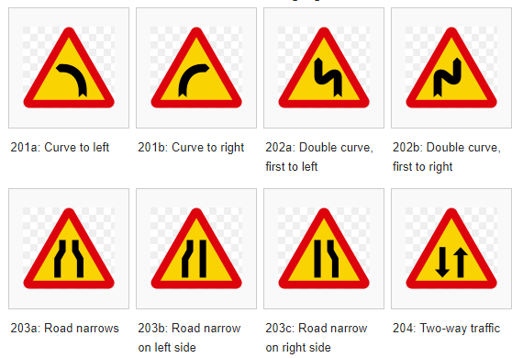
HOW: Obey traffic signs and signals
Danger warning signs:
Notes:
are red bordered yellow triangles.

Slide 15
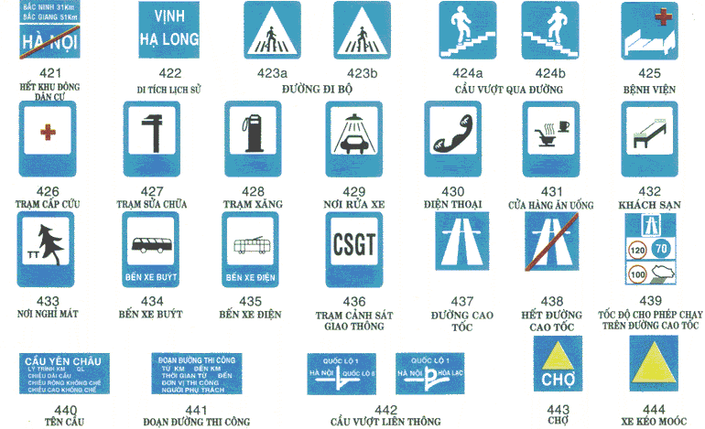
HOW: Obey traffic signs and signals
Information signs:
Notes:
are blue rectangles.

Slide 16




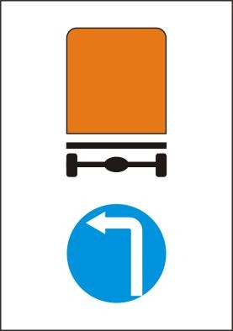



HOW: Obey traffic signs and signals
Mandatory signs:
Notes:
- normally are blue circle
- straight ahead or turning right
- roundabout
- honk

Slide 17
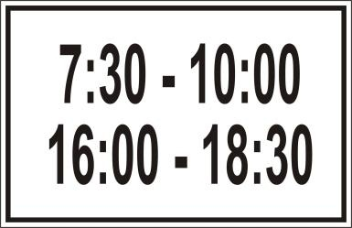
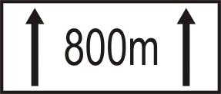
HOW: Obey traffic signs and signals
Additional signs
Notes:
Yield to oncoming traffic

Slide 18
HOW: Driver factor – other things
Wear a helmet/seat belts.
Don't drive if you're not feel good health.
Don’t drink beer, Alcohol and drugs impair.
Don’t overload.
Make sure cargo is properly secured.
Clear vision.
Slow speed is amost better.
...
Notes:
- impair: pare down
- seat belts: to protected passengers/drivers to against harmful movement or sudden stop

Slide 19
HOW: Safe driving
Q & A

